Slide 1
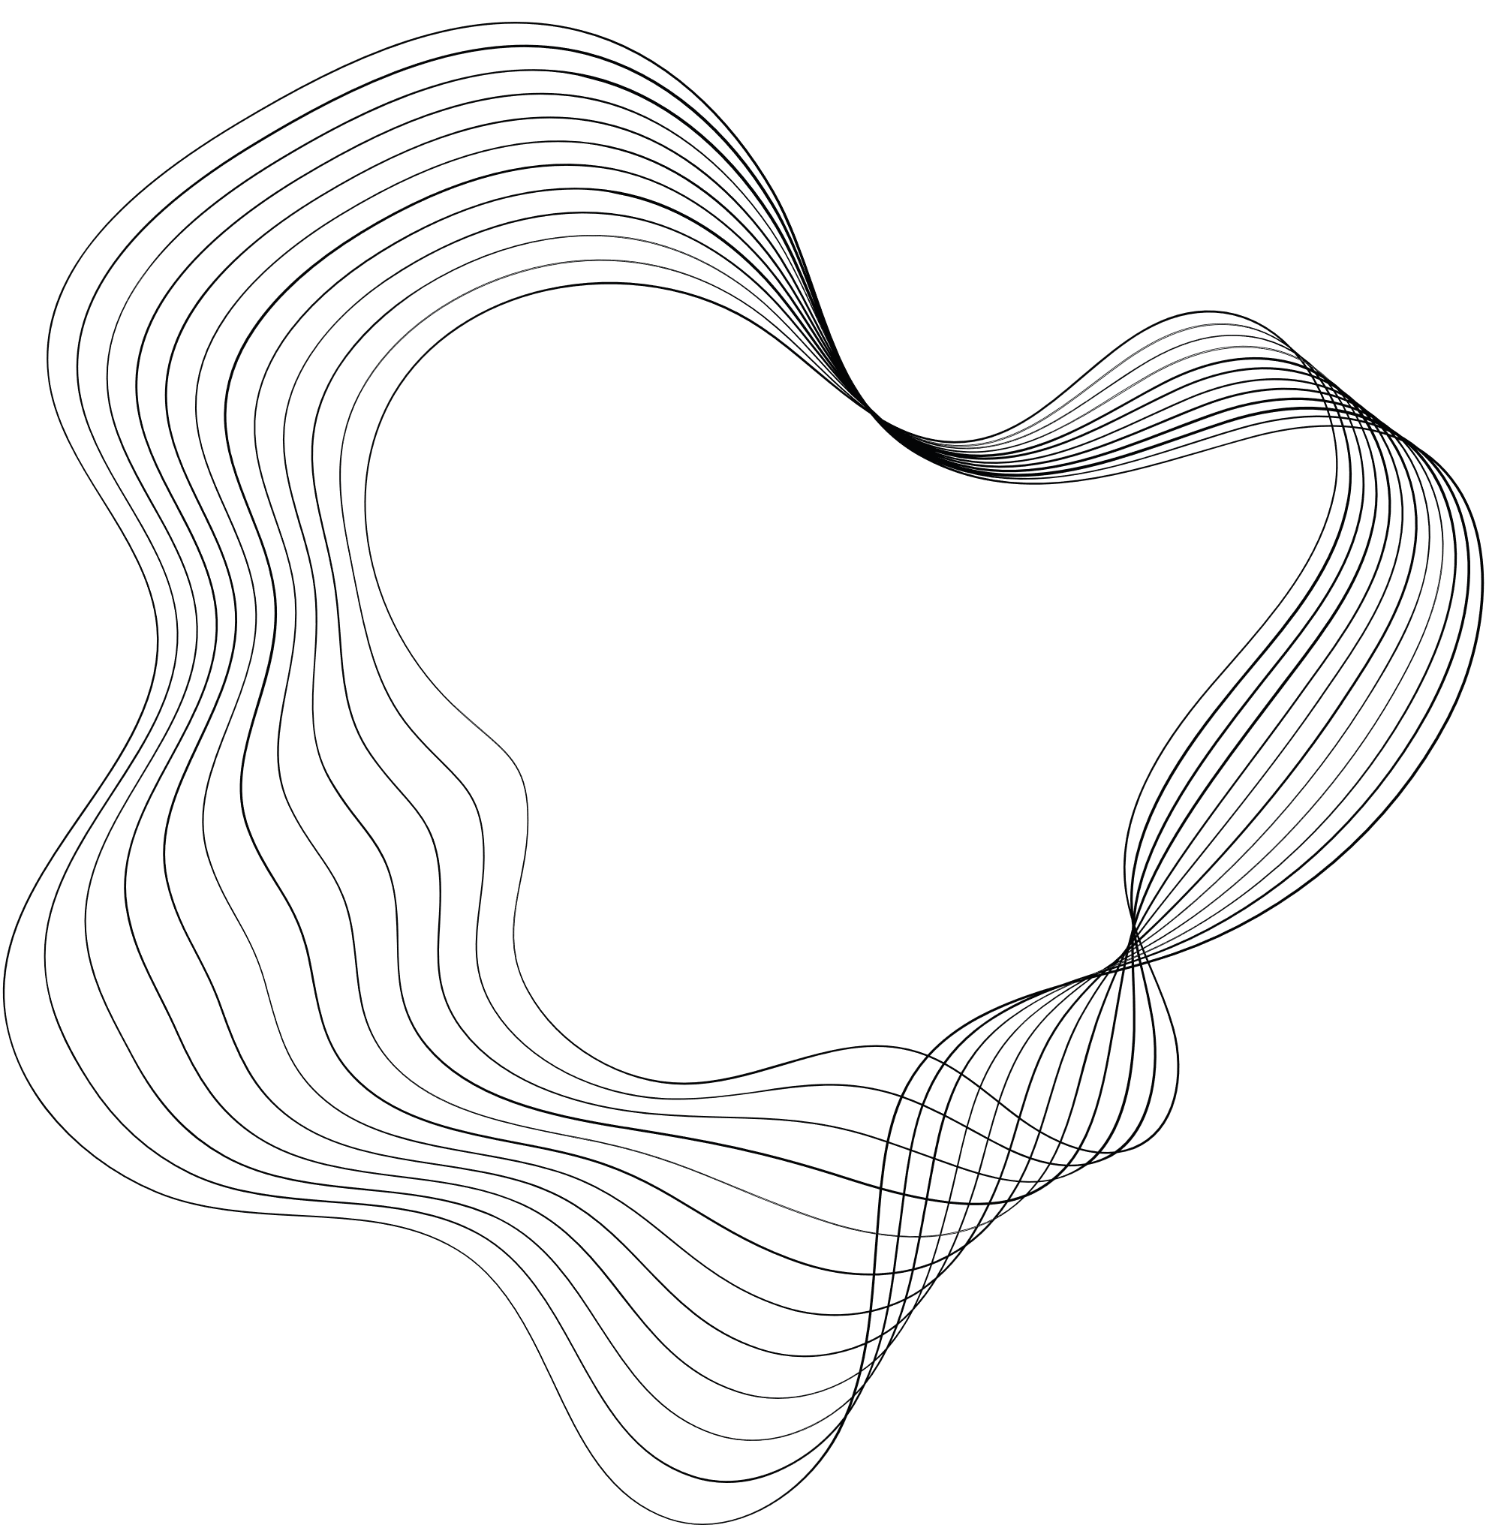


Measure
UP
B Y L E P T O N S
HTTPS://MEASUREUPLEPTONS.WIXSITE.COM/MEASUREUP

Slide 2
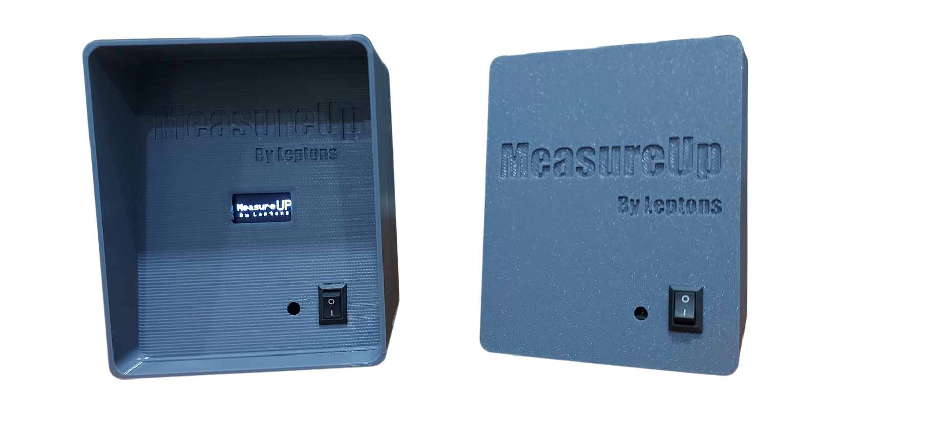
WHAT IS MEASUREUP?
The ultrasonic height measuring device is a portable and independent device designed to measure patients' heights accurately in clinics
WHY CHOOSE MEASUREUP?
This wireless device helps medical clinics to fully automate the height measuring process

Slide 3
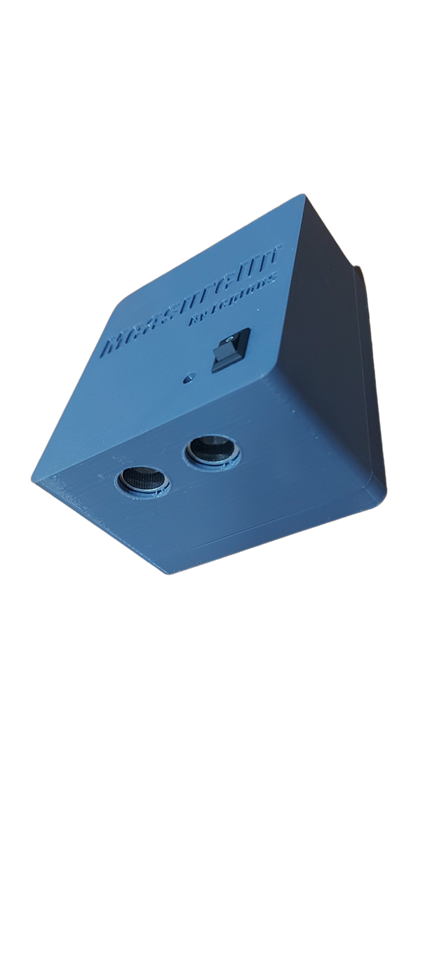
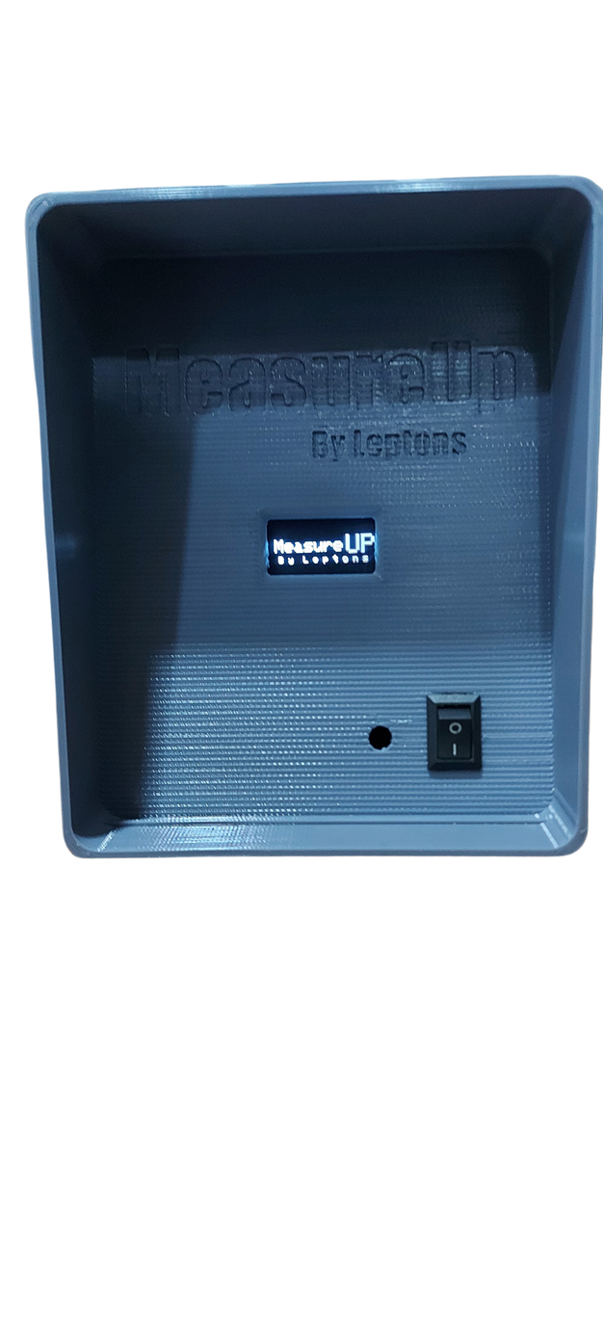


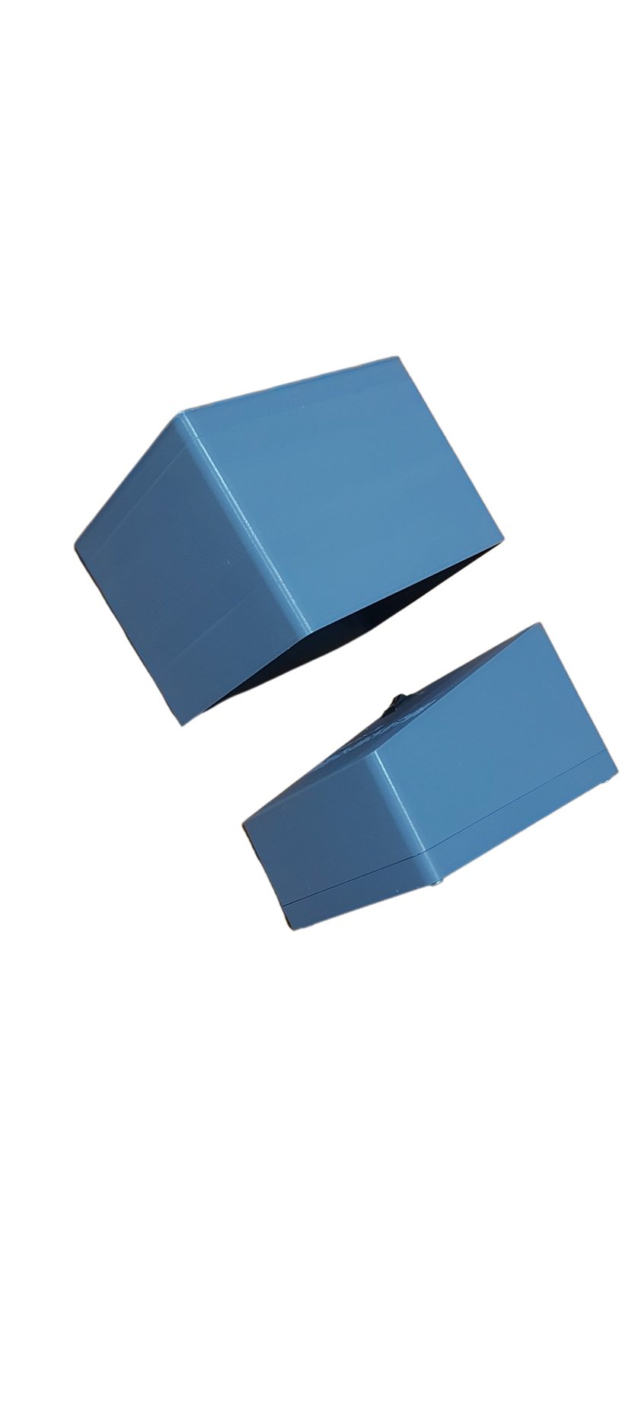
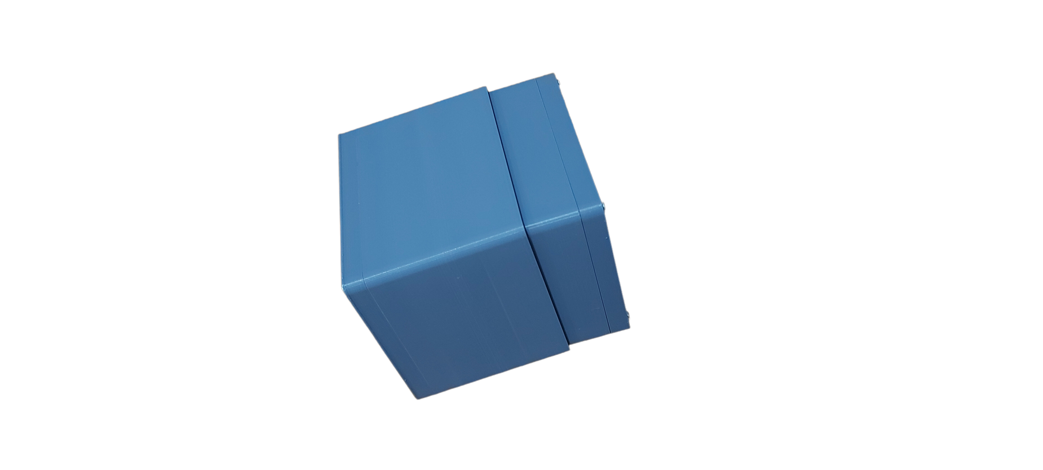


SPECIFICATIONS
MeasureUp comprises of two parts;
.
Height-measuring device
.
Wireless display unit
.
Despite having two parts, our device is ingeniously designed to nest one within the other, resulting in a single, unified device
.

Slide 4





Patient doesn't require third-party guidance; the in built buzzer will guide them.
No need of a phone, PC or a laptop. The wireless display will display the height measure
Measured height in Feet and in Centimetres
IMPERIAL
METRIC

Slide 5


CHALLENGES WE FACED
Initially we designed MeasureUp using Bluetooth modules
After the feedback we received at the initial project evaluation we decided to use NRF modules and fully automate the process without using PCs, Phones or Laptops
At that we phase since we have already designed a PCB it was a challenge to change it according to the current need

Slide 6
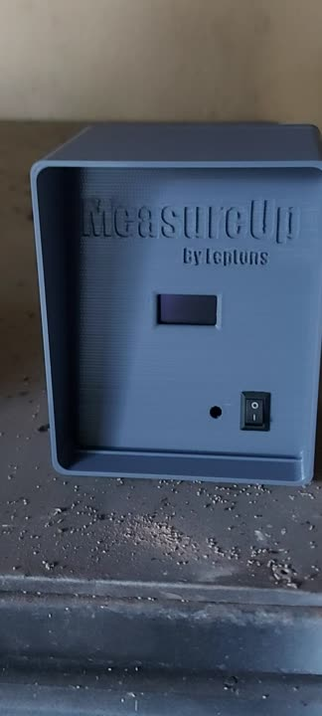

TESTING
OUR
PRODUCT

Slide 7





OUR TEAM
Risini Kumarasinghe
Nadun Rajapakshe
Chathura Weerasinghe
Isiri Withanawasam
Index no : 210321X
Index no : 210504L
Index no : 210687X
Index no : 210732H

Slide 8
THANK YOU!

